Slide 1
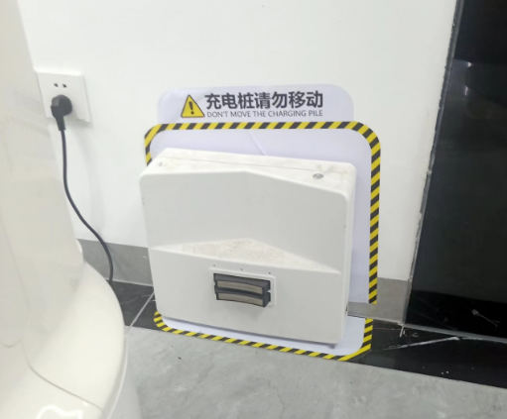
Here are some tips, please be in mind
Once you set up the charging station, please DO NOT move it. Otherwise, everything you do is in vain.
TIP 1: DO NOT MOVE THE CHARGING STATION

Slide 2
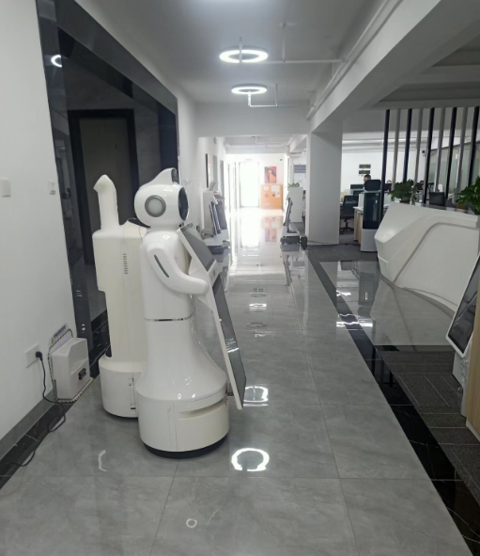
TIP 2: DO NOT let something or someone stand in front of the robot when you make scanning

Slide 3
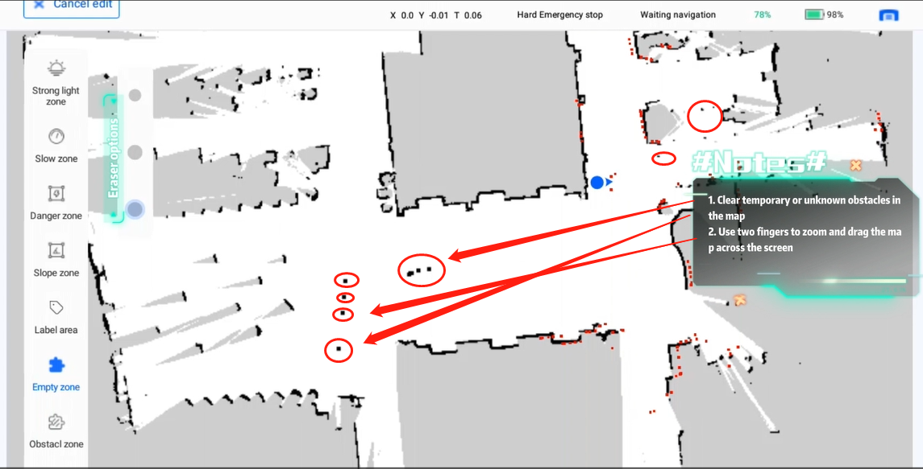
TIP 3: REMOVE these black spots
black spots=temporary or unknown obstacles
Please see the video of 02 Edit the map

Slide 4
